Slide 1
Computer Vision SIFT
Scale Invariant Feature Transform

Slide 2
AGENDA
Introduction.
The scale space.
LoG Approximation .
Finding keypoints.
Get rid of bad key points.
Assigning an orientation to the keypoints.
Generate SIFT features.

Slide 3

Image Formation

Slide 4
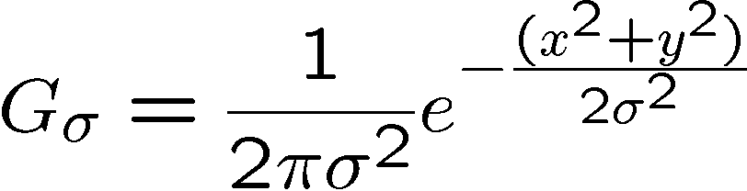
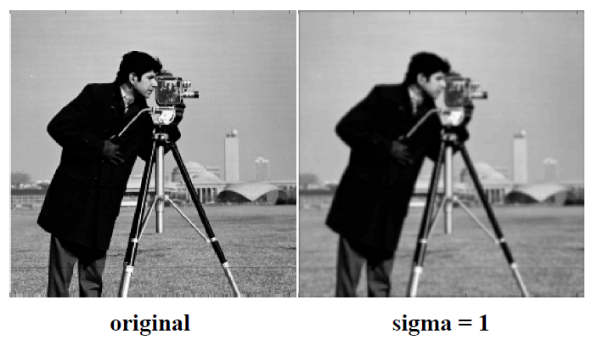
Gaussian filter- examples
Gaussian distribution

Slide 5
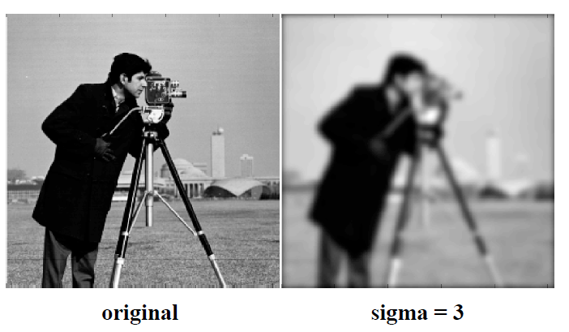
Gaussian filter-examples

Slide 6
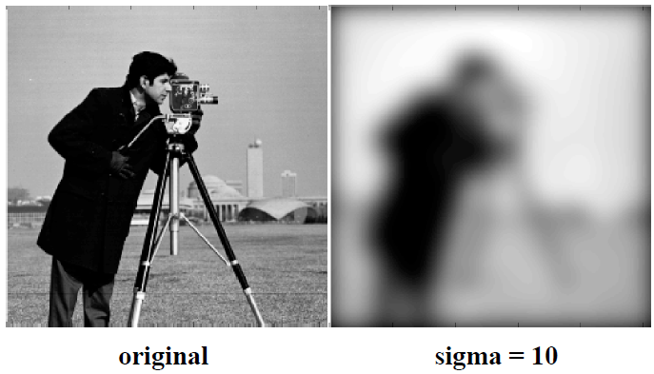
Gaussian filter-examples

Slide 7
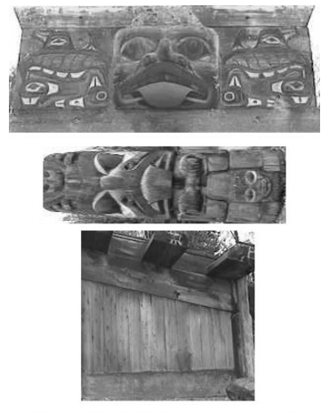
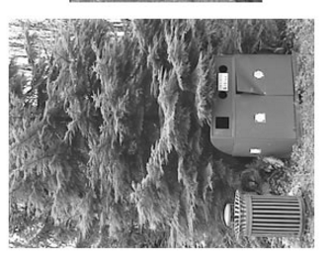
Why care about SIFT
SIFT isn't just scale invariant. You can change the following, and still get good results:
Scale .
Rotation.
Illumination.
Viewpoint.

Slide 8
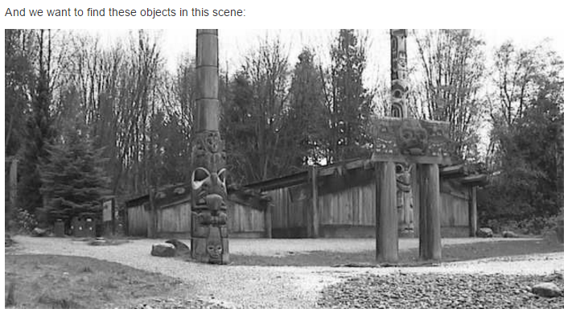
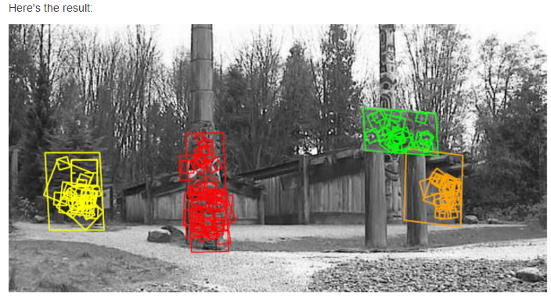

Slide 9
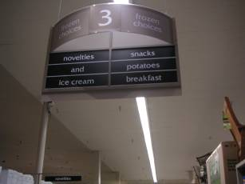
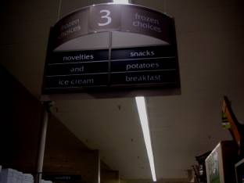
Types of invariance
Illumination

Slide 10
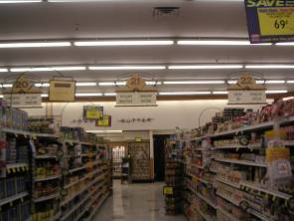
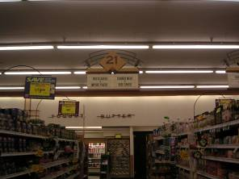
Types of invariance
Illumination
Scale

Slide 11
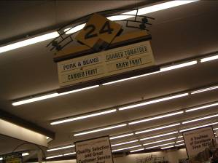
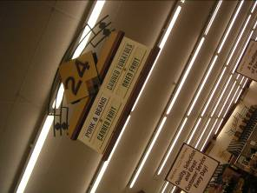
Types of invariance
Illumination
Scale
Rotation

Slide 12
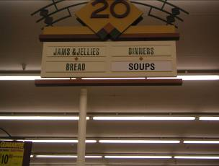
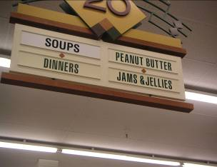
Types of invariance
Illumination
Scale
Rotation
Affine

Slide 13
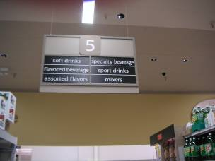
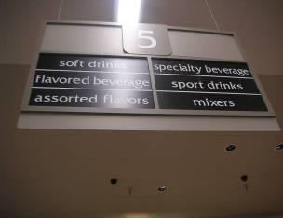
Types of invariance
Illumination
Scale
Rotation
Affine
Full Perspective

Slide 14
AGENDA
Introduction.
The scale space.
LoG Approximation .
Finding keypoints.
Get rid of bad key points.
Assigning an orientation to the keypoints.
Generate SIFT features.

Slide 15
The scale space
Do you want to look at a leaf or the entire tree? If it's a tree, get rid of some detail from the image (like the leaves, twigs, etc) intentionally.
The only way to do that is with the Gaussian Blur.
So to create a scale space, you take the original image and generate progressively blurred out images

Slide 16
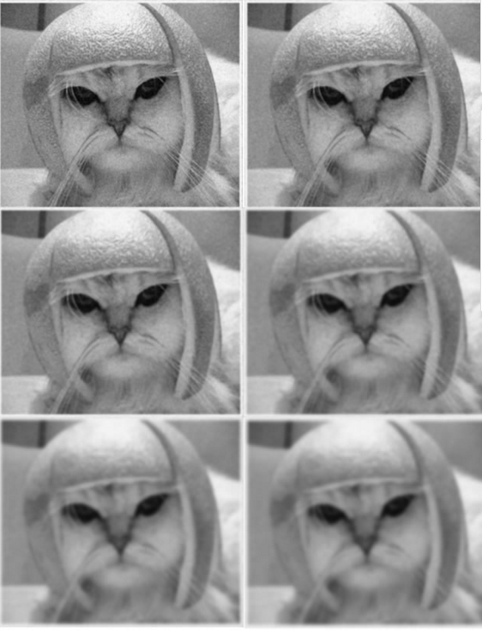
Here's an example:

Slide 17
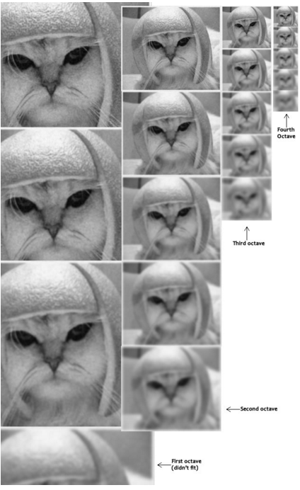
Scale spaces in SIFT
SIFT takes scale spaces to the next level. You take the original image, and generate progressively blurred out images. Then, you resize the original image to half size. And you generate blurred out images again. And you keep repeating.
Here's what it would look like in SIFT:

Slide 18
Technical Details
Octaves and Scales:
The number of octaves and scale depends on the size of the original image. While programming SIFT, you'll have to decide for yourself how many octaves and scales you want. However, the creator of SIFT suggests that 4 octaves and 5 blur levels are ideal for the algorithm.
The first octave:
If the original image is doubled in size and antialiased a bit (by blurring it) then the algorithm produces more four times more keypoints. The more the keypoints, the better!

Slide 19
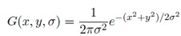
Blurring
Mathematically, "blurring" is referred to as the convolution of the gaussian operator and the image. Gaussian blur has a particular expression or "operator" that is applied to each pixel. What results is the blurred image.
The symbols:
L is a blurred image
G is the Gaussian Blur operator
I is an image
x,y are the location coordinates
σ is the "scale" parameter. Think of it as the amount of blur. Greater the value, greater the blur.
The * is the convolution operation in x and y. It "applies" gaussian blur G onto the image I.
This is the actual Gaussian Blur operator.

Slide 20
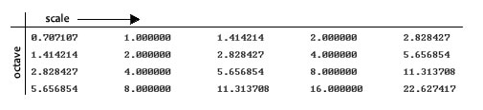
Amount of blurring
The amount of blurring in each image is important. It goes like this. Assume the amount of blur in a particular image is σ. Then, the amount of blur in the next image will be k*σ. Here k is whatever constant you choose.
See how each σ differs by a factor sqrt(2) from the previous one.

Slide 21
AGENDA
Introduction.
The scale space.
LoG Approximation .
Finding keypoints.
Get rid of bad key points.
Assigning an orientation to the keypoints.
Generate SIFT features.

Slide 22
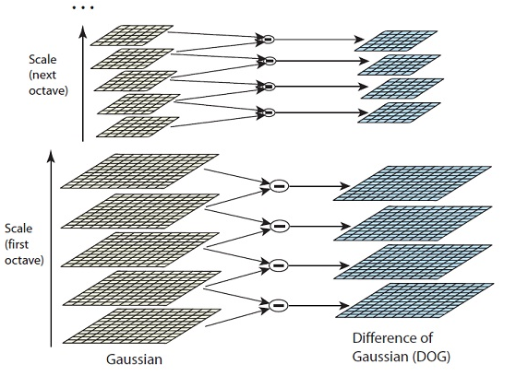
LoG approximations
Laplacian of Gaussian:
These Difference of Gaussian images are approximately equivalent to the Laplacian of Gaussian. And we've replaced a computationally intensive process with a simple subtraction (fast and efficient).

Slide 23
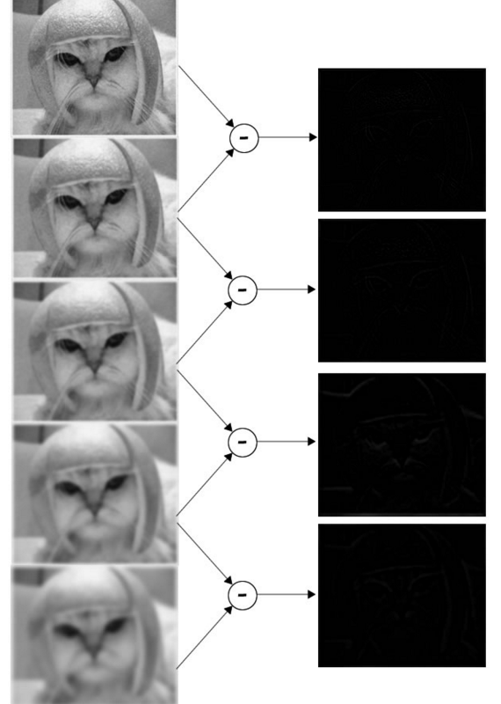
Example

Slide 24
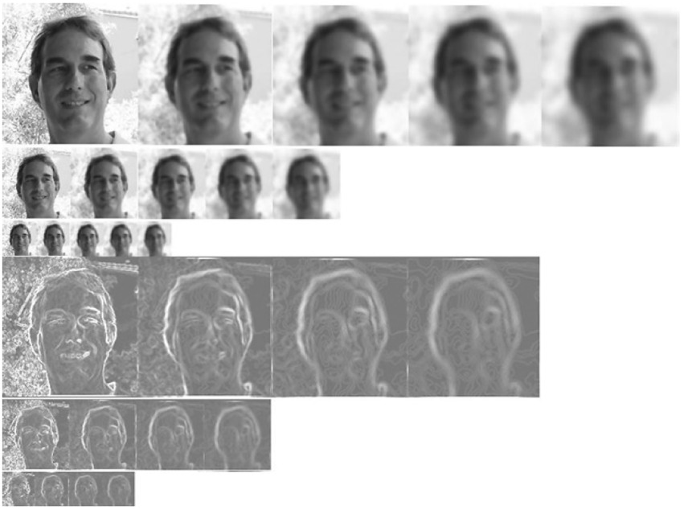

Slide 25
AGENDA
Introduction.
The scale space.
LoG Approximation .
Finding keypoints.
Get rid of bad key points.
Assigning an orientation to the keypoints.
Generate SIFT features.

Slide 26
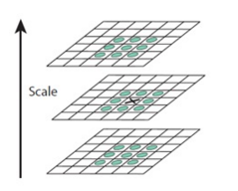
Finding keypoints
Locate maxima/minima in DoG images
The first step is to coarsely locate the maxima and minima. This is simple. You iterate through each pixel and check all it's neighbours. The check is done within the current image, and also the one above and below it. Something like this:

Slide 27
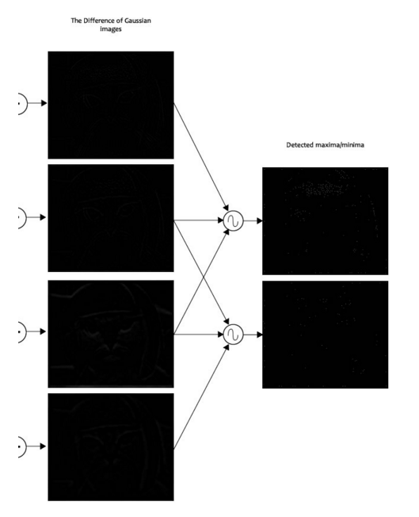
Example

Slide 28
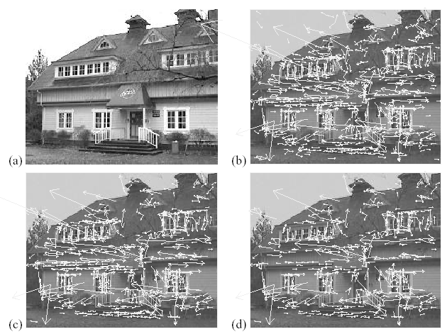
Keypoint Localization (cont’d)
(a) 233x189 image
(b) 832 DoG extrema
(c) 729 left after low
contrast threshold
ratio based on Hessian

Slide 29
AGENDA
Introduction.
The scale space.
LoG Approximation .
Finding keypoints.
Get rid of bad key points.
Assigning an orientation to the keypoints.
Generate SIFT features.

Slide 30
Getting rid of low contrast keypoints
Removing low contrast features
This is simple. If the magnitude of the intensity (i.e., without sign) at the current pixel in the DoG image (that is being checked for minima/maxima) is less than a certain value, it is rejected.

Slide 31
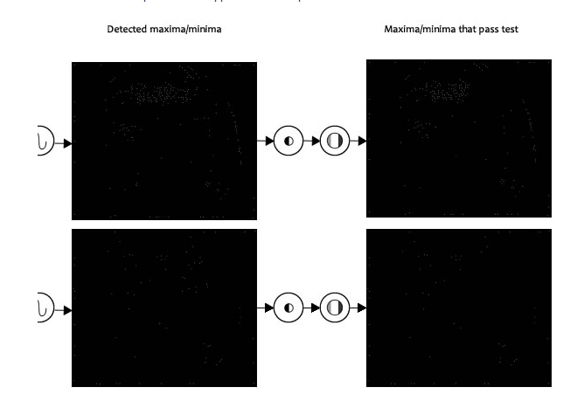
Example

Slide 32
AGENDA
Introduction.
The scale space.
LoG Approximation .
Finding keypoints.
Get rid of bad key points.
Assigning an orientation to the keypoints.
Generate SIFT features.

Slide 33
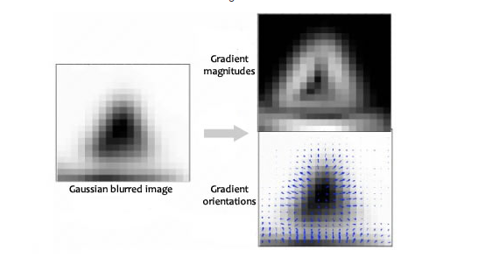
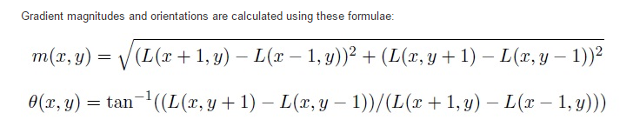
Keypoint orientations

Slide 34
Keypoint orientations
The magnitude and orientation is calculated for all pixels around the keypoint. Then, A histogram is created for this.
In this histogram, the 360 degrees of orientation are broken into 36 bins (each 10 degrees). Lets say the gradient direction at a certain point (in the "orientation collection region") is 18.759 degrees, then it will go into the 10-19 degree bin. And the "amount" that is added to the bin is proportional to the magnitude of gradient at that point.
Once you've done this for all pixels around the keypoint, the histogram will have a peak at some point.
you see the histogram peaks at 20-29 degrees. So, the keypoint is assigned orientation 3 (the third bin)
Also, any peaks above 80% of the highest peak are converted into a new keypoint. This new keypoint has the same location and scale as the original. But it's orientation is equal to the other peak.
So, orientation can split up one keypoint into multiple keypoints.

Slide 35
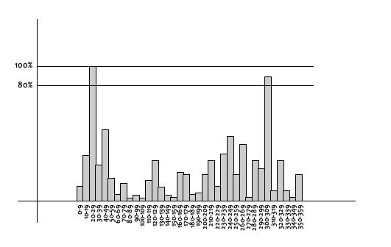
Keypoint orientations

Slide 36

Orientation Assignment
Create histogram of gradient directions, within a region around the keypoint, at selected scale:
36 bins (i.e., 10º per bin)
0
2
π

Slide 37
AGENDA
Introduction.
The scale space.
LoG Approximation .
Finding keypoints.
Get rid of bad key points.
Assigning an orientation to the keypoints.
Generate SIFT features.

Slide 38
Keypoint Descriptor
8 bins

Slide 39
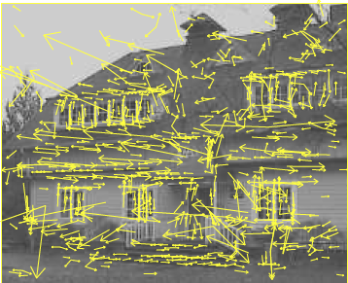

Slide 40
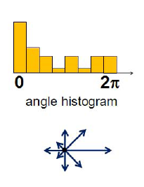
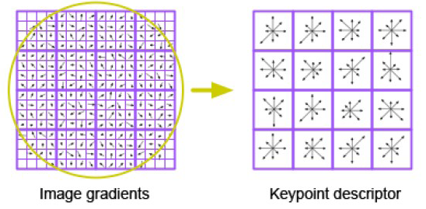
Keypoint Descriptor (cont’d)
Take a 16 x16 window around detected interest point.
Divide into a 4x4 grid of cells.
Compute histogram in each cell.
(8 bins)
16 histograms x 8 orientations
= 128 features

Slide 41
Applications of SIFT
Object recognition
Object categorization
Location recognition
Robot localization
Image retrieval
Image panoramas
Notes:
41

Slide 42
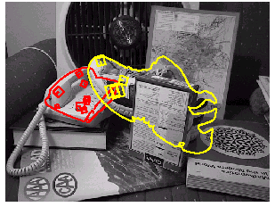
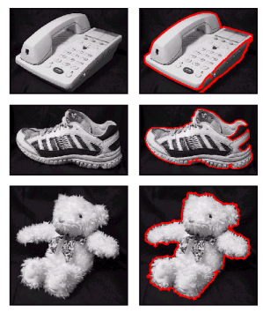
Object Recognition
Object Models

Slide 44
Object Categorization
Notes:
44

Slide 45
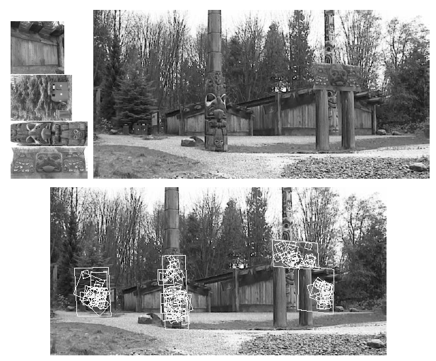
Location recognition
Notes:
45

Slide 46
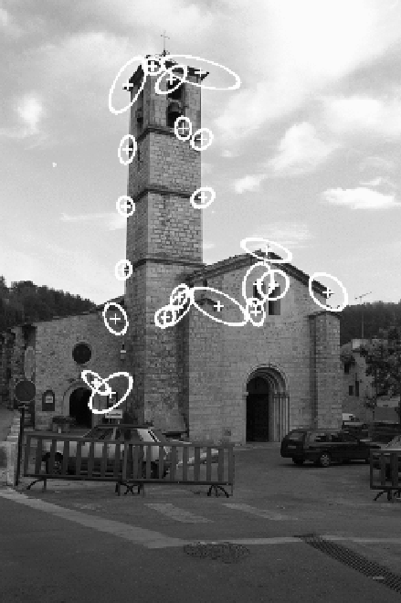
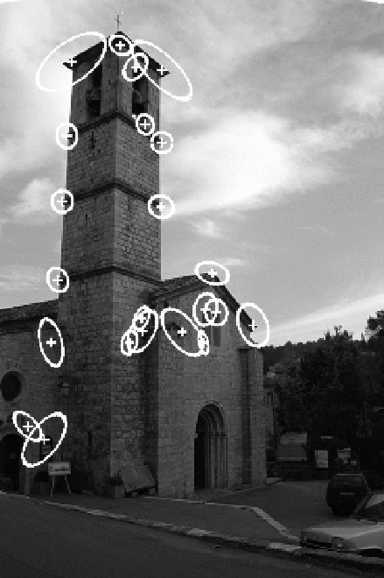
Matches
22 correct matches
Notes:
46
CS4495/7495 2004
10/19/2025
Local Invariant Features
46

Slide 47
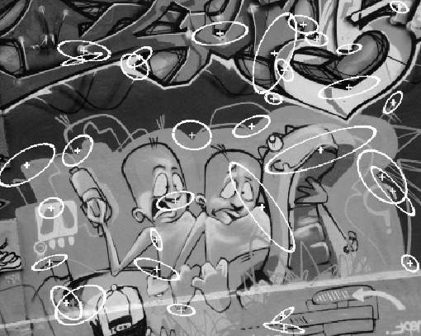
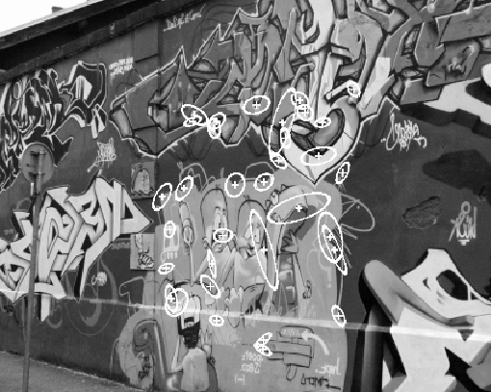
Matches
33 correct matches
Notes:
47
CS4495/7495 2004
10/19/2025
Local Invariant Features
47

Slide 48







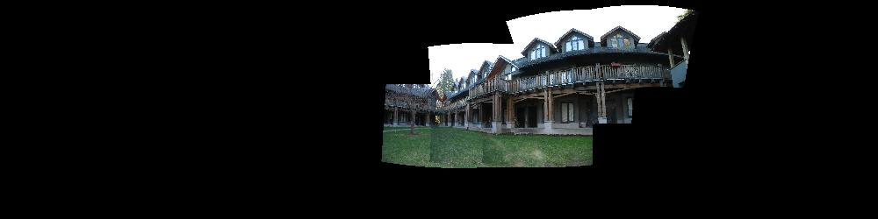
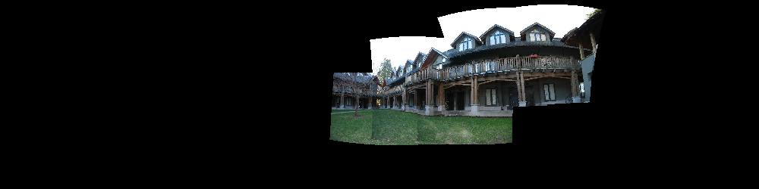
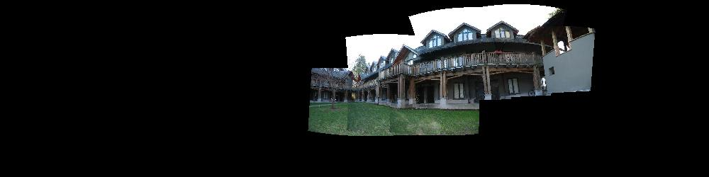
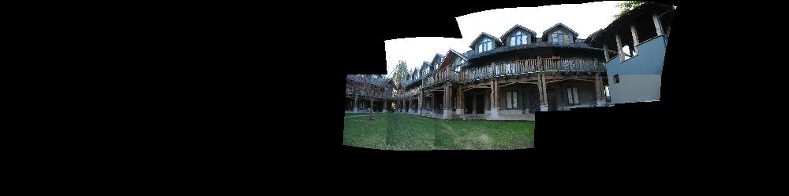
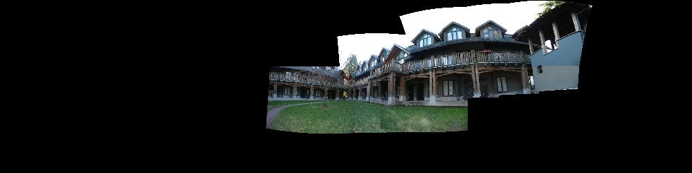
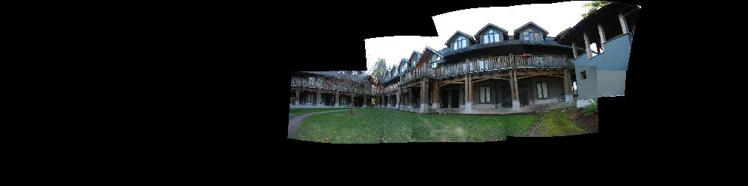
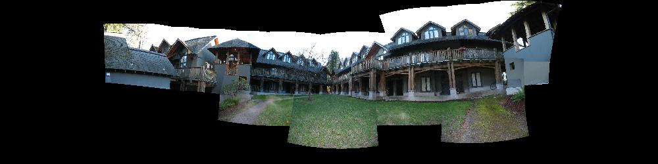
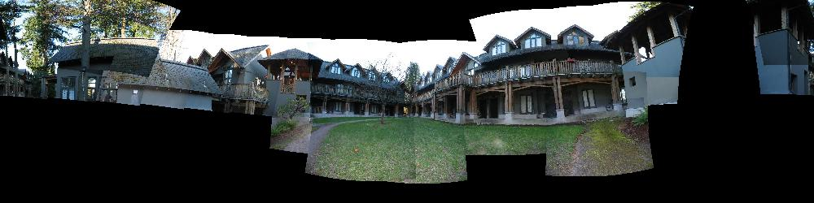








Image Registration
Notes:
48

Slide 49
Applications

Slide 50



Fingerprint Identification Research at UNR
Minutiae Matching
Delaunay Triangulation

Slide 51


Object Recognition

Slide 52


Target Recognition
Department of Defense (Army, Airforce, Navy)

Slide 53


Traffic Monitoring

Slide 54


Face Detection

Slide 55

Face Recognition

Slide 56

Facial Expression Recognition

Slide 57

Human Activity Recognition

